Slide 1



Raj Kumar Goel Institute of Technology
Presented
On
Bidirectional Transmission of WDM-based XGPON System with SRM and a Post DCF
(PID: 144)
Presented by:
Divyanshu Srivastav
Gaurav Rajput
Neeraj Bharti
PROJECT GUIDE:
DR. RL YADAV

Slide 2

Table Of Contents
ABSTRACT
LITRATURE REVIEW
EXISTING METHOD
PROPOSED METHOD
ADVANTAGES AND APPLICATION
CONCLUSION

Slide 3

Abstract
As we are know, the demand for higher data rates is increasing day by day for a range of digital activities that require seamless and uninterrupted online performance. So we go for optical fiber networks which allows us to achieve higher data rates up to 1Gbps.
How can we further enhance this speed up to 100 Gbps or more?
We can use WDM based XG-PON which is a technique of multiplexing multiple optical carrier signals of different wavelength through a single optical fiber channel.
What is PON and how is PON different from AON ?
PON comprises of passive components such as splitter , combiner ,fork etc. which do not require external power equipment. AON is more flexible but complex and costly.
This architecture is used to transfer high data rates while ensuring network reliability and wider network coverage.
The performance is enhanced by using SRM designed on matlab and DCF to compensate for the square law characteristics of photodiode present in ONUs.

Slide 4
PASSIVE OPTICAL NETWORK
A PON is a point-to multipoint optical network that uses passive optical components such as splitter coupler and splicer.
PON technology has two essential characteristics that make it a good choice for a broadband access network.
It supports point-to-multipoint architecture and allow multiple customers to share a single fibre facility .
A PON system does not require much maintenance because of the passive nature of components of a PON.

Slide 5
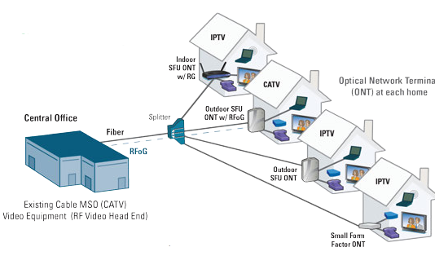
Cont. PON Architecture

Slide 6
OPTICAL LINE TERMINAL(OLT)
OLT is the headend of an optical cable network located at service provider’s central office CO.
It broadcasts the downstream data to the connected ONUs over a single fiber/
It aggregates upstream traffic from multiple customer sites. It can use one of several multiplexing techniques such as TDM,CDM, or WDM.
It is responsible for interfacing metro backbone networks and performing network protocol conversions.

Slide 7
OPTICAL NETWORK UNIT
Optical Network Unit PON system terminates at ONUs, also know as Optical Network terminals (ONTs).
It converts optical signals to electrical signals and then to an application bandwidth for a user end terminal such as a PC , a TV, a home hub, enterprise routers etc.
It generates optical signals for upstream traffic.
It interfaces last-yard access device like a wireless LAN at customer premises.

Slide 8

EXISTING MODEL
CHANNEL
Optical Fiber
RECEIVER
Photodetector
BER Analyzer
3R Regenerator
NRZ Pulse Modulator
Demultiplexer
PRBS
Multiplexer
CW Laser
SRM
EDFA Amplifier
TRANSMITTER

Slide 9
Proposed Method
The post-dispersion compensation fiber (DCF) is used to compensate for the chromatic dispersion effects.
The post-DCF is inserted after the square root module to further improve the system's performance.
The proposed system architecture includes a square root module, post DCF, optical modulator, optical amplifier, and a receiver at both ends of the fiber link.
The combination of DCF with SRM result in least BER and higher Q factor which reduces the overall attenuation in the system.
Without SRM and DCF, We get 12.3701 Q-factor and BER of 4.1×10^-35 at 100 Km while with SRM and PDCF we get Q-factor of 17.2771 and BER of 3.49×10^-17 at 100 Km.

Slide 10
ADVANTAGES
Increased Transmission Distance:
DCM extends the reach of XGPON systems by compensating for signal dispersion, allowing for longer transmission distances.
Enhanced Signal Quality:
Improves signal integrity by mitigating the effects of chromatic and polarization mode dispersion, ensuring high-quality data transmission.
Higher Data Rates:
Enables the support of higher data rates by minimizing signal distortion, contributing to improved overall network performance.
Greater Bandwidth Utilization:
Optimizes bandwidth usage by reducing signal degradation, allowing for more efficient utilization of the available optical spectrum.
Improved System Reliability:
Enhances system reliability and reduces the likelihood of signal impairments, leading to a more robust and dependable XGPON network.

Slide 11
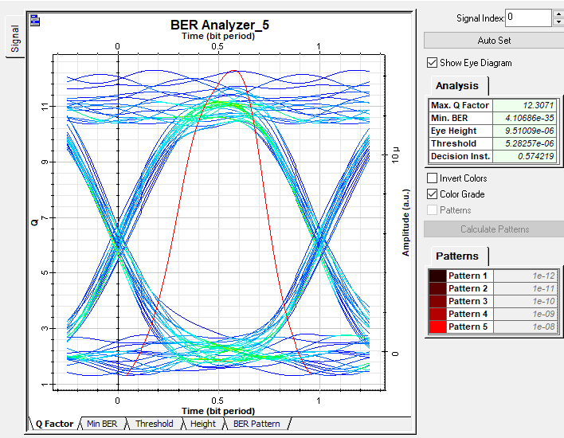
RESULTS AND EYE DIAGRAM
The subsystem consist of 32 ONU and transmitted 10Gbps data on each channel. Thus we transmitted 320 Gbps data through a single optical fiber.
Without SRM and PDCF simulated figure.

Slide 12
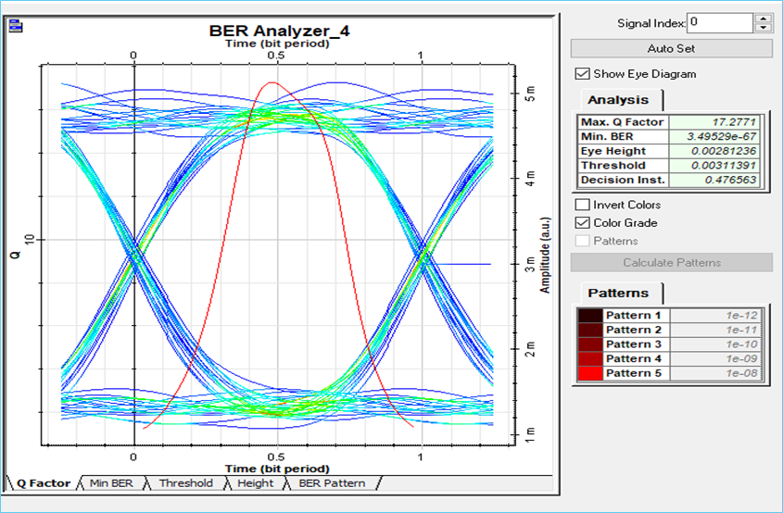
Eye Diagram and Simulation Results
With SRM and PDCF simulated figure.

Slide 13
APPLICATION
DCF in Wavelength Division Multiplexing (WDM)-based XGPON systems optimizes channel allocation, boosting overall bandwidth efficiency.
DCF enables dynamic allocation of wavelength channels, adapting to varying traffic demands and ensuring efficient utilization of network resources.
Dynamic wavelength allocation accommodates increasing data traffic.

Slide 14
Conclusion
The research introduces a bidirectional communication system that combines Sub-Carrier Modulation (SCM), Wavelength Division Multiplexing (WDM), and Radio-over-Fiber (RoF) technologies. The system incorporates a unique square root module and uses post-dispersion compensation fiber.
Simulation results confirm the effectiveness of the proposed system. It achieves an impressively low Bit Error Rate (BER) of less than 10^-9, indicating highly accurate data transmission.
The use of 10-GPON started as a result of rising bandwidth demands. The SCM/WDM10GPON-RoF bidirectional system is demonstrated in this work using SRM at 1577 nm for downlink transmission and 1270 nm for uplink transmission.
SRM and DCF on the receiver side has been suggested and designed using MATLAB, which played a key role for improving the proposed system’s execution.
The primary goal of this system is to significantly enhance optical communication. It aims to achieve higher data transmission rates, extend the distance over which signals can be sent, and improve the overall quality of the transmitted signals.

Slide 15


